Slide 1
Secure Data Hiding In Images Using Steganography
AICTE PROJECT
Presented By: Abhishek Kumar Yadav
College Name: Sri Aurobindo Institute of Technology, Indore(M.P.)
Department : Electrical and Electronics Engineering

Slide 2
OUTLINE
Problem Statement
Technology used
Wow factor
End users
Result
Conclusion
Git-hub Link
Future scope

Slide 3
Problem Statement
Whenever sharing a confidential message/data, confidentiality is utmost priority.
Traditional cryptography/ciphering is widely known so easy to recognise and decipher.
Needed a way which can disguise the message as a normal image, and message is password protected

Slide 4
Technology used
Platform: Windows
Programming language: Python
Library : OpenCV

Slide 5
Wow factors
Hides the text message in an image format without noticeable difference.
Encrypts the file without changing its extension.
Encrypts the data without significantly changing the size of image file.
The encrypted file can be shared around and still holds the data.
Since its LSB steganography, it doesn’t affects the quality of the image.

Slide 6
End users
Banking sector: Bank to bank or bank to customer
Government Entity: Defence, secret services to communicated within and with each other.
Cybersecurity personals: To infest a system or to securely communicate.
Journalists: Securely transfer piece of information without the information getting leaked.

Slide 7
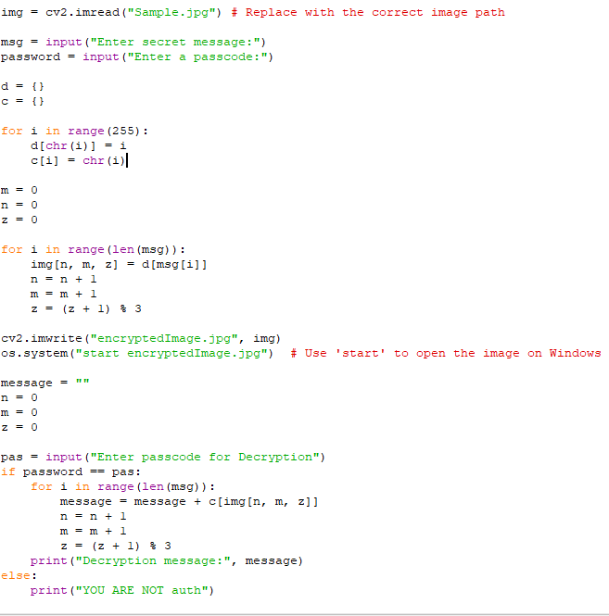


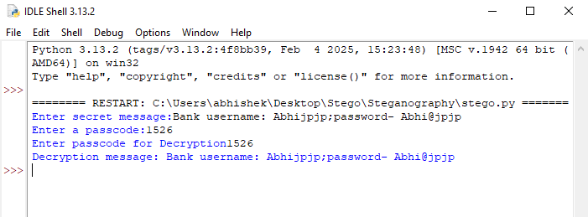
Results
Input Image
Encrypted image
Code
Decrypted message

Slide 8
Conclusion
Hiding text in an image file is incredibly useful in a lot of situations.
Provides data privacy from general public
However it can be detected by a skilled person and can also be decrypted by brute force as it doesn’t offer limited no. of tries.
Can be used to sent malwares and infest devices by threat attacks

Slide 9
GitHub Link
https://github.com/itsAByadav/AICTE-Steganography.git

Slide 10
Future scope(optional)
Expansion to audio and video steganography.
Non detectable by AI.
Auto-destructible(encrypted data is available for limited period of time)

Slide 11
THANK YOU

